Slide 1
Behold Bootstrap
Coding Boot Camp
Notes:
Groups for rest of the day, think about a name if you want one, otherwise we’ll be team 1-n
3 for 1st, 2 for 2nd, 1 for all else. Group that finishes first/second/third/etc.
Raising hands: who finished off the homework with minimal effort? Who finished just using google and what they learned? Who had the courage to ask others for help? Who actually helped out and lent a hand?

Slide 2
Today’s goals
Use the viewport tag to ensure optimal display.
Use media queries to create a responsive design.
Create layouts using Twitter Bootstrap.
And, have fun!

Slide 3
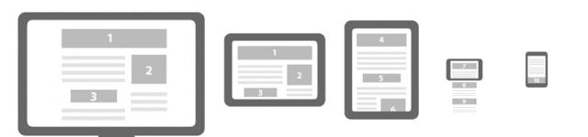
Responsive design: viewport
The viewport is the area of the browser showing your webpage.
It can be dramatically different physical sizes and resolutions.
We always want our page to scale correctly to the users viewport.

Slide 4
Responsive design: viewport
<meta name=“viewport” content=“width=device-width, initial-scale=1”>
My site’s width will scale to your devices width.
It should scale pixel for pixel.
Place this in the head above title, and link tags.

Slide 5
Assignment: screen sizes
Use http://www.mobilephoneemulator.com/ to visit your favorite sites using a variety of devices.
Notice how sites change at different screen sizes.
Take screenshot of any interesting findings you come across and share them on slack.
Notes:
http://www.mobilephoneemulator.com/
Group with the most interesting screenshots wins. Make sure to put your group name when dropping a screenshot.

Slide 6
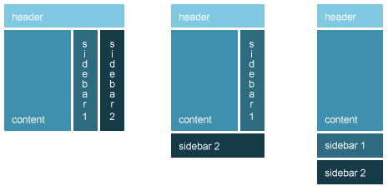
Responsive design: media queries
Media queries apply style based on characteristics of the viewing device.
With media queries you can change how your page displays based on width, height, orientation, and resolution.

Slide 7
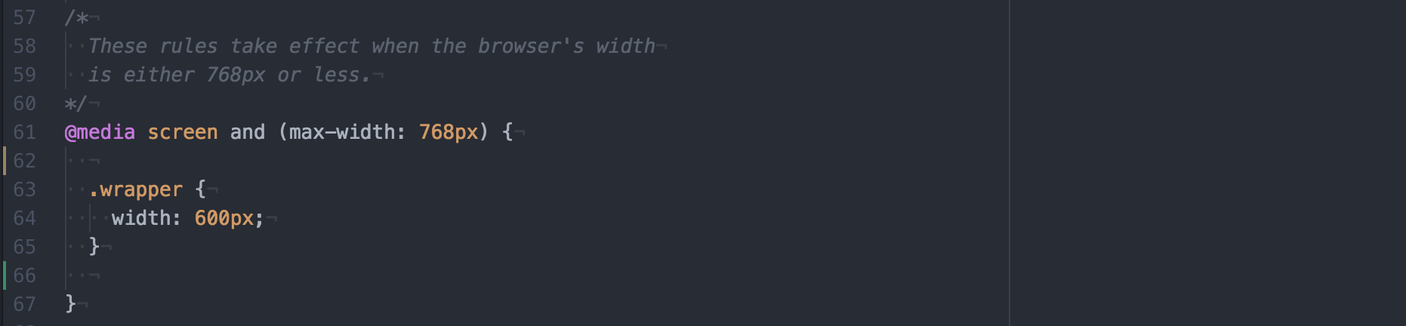
Responsive design: media queries

Slide 8
Assignment: responsive design
Grab the HTML Document and CSS from slack and include a viewport tag in head.
Use media queries to change the layout so that a smaller screen has a better presentation of the sidebar and content.
Make a smaller <nav> and bigger <article>.
Only show the 1.1, 1.2, 1.3 as links.
Notes:
Points for quickest finished.

Slide 9
Bootstrap: recap
Include the bootstrap style and javascript from CDN.
Use classes and structure prescribed by bootstrap.
Leverage a wide variety of proven interface elements.
Take advantage of automatic responsive design.
Bootstrap documentation is your friend, today and forever.

Slide 10
Assignment: Get your feet wet
Continuing with the same HTML Document, include bootstrap style and script.
Remove normalize and typeplate, since bootstrap handles that.
Remove all the style from our css file. (keep the fonts if you like)
Add a jumbotron around <header>.
jumbotron should be a div, give <header> the class ”container”
See the style in slack to give it a background.
Make our nav into bootstrap pills.
Add the classes “nav nav-pills nav-stacked” to the <ul>
Notes:
Putting a container in a jumbotron makes it full-width.
Points for quickest finished

Slide 11
Layouts: sketching
Before we diving into any project, we need to know what we’re doing.
Start with content, what needs to be on the page.
Plan out where it will go, paper or whiteboard are great for this.
Move things around until you’ve got a good feeling about it.

Slide 12
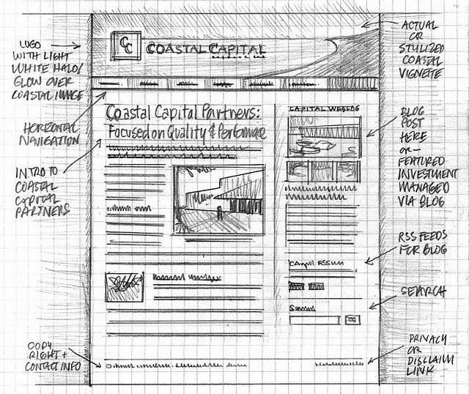
Layouts: sketching

Slide 13
Layout: wire-framing
After we have an agreeable design, we make something more solid.
We don’t want to give the impression we’re nearly done, so we intentionally make it look incomplete (its faster that way too).
Don’t include real content.
Don’t include real images.
It should look like it could be a webpage.

Slide 14
Layout: wireframing

Slide 15
Layout: grids
We make extensive use of grids in layout, they give us a good way of thinking about where things go.
Grids create aesthetically appealing designs with the ratios our eyes like.

Slide 16
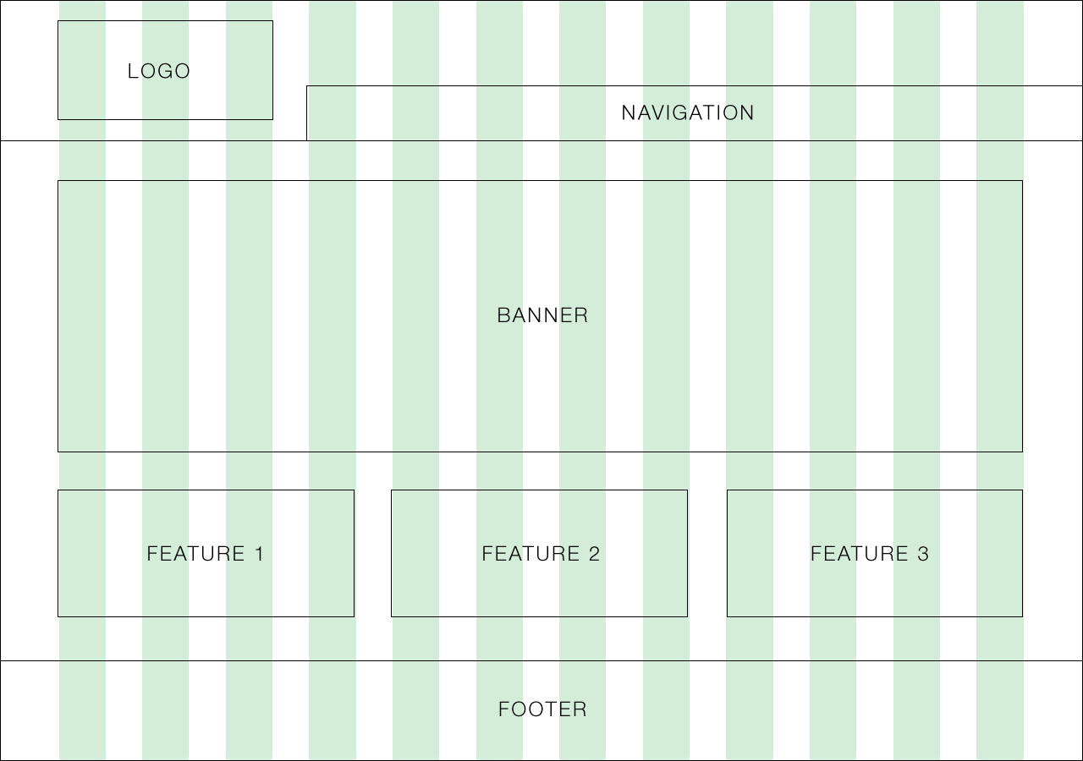
Layout: grids

Slide 17
Grid workshop
For each wireframe coming up:
How many rows?
How many columns per row?
Notes:
Raise you hand (don’t yell it out).
First to answer correct gets a point.

Slide 18
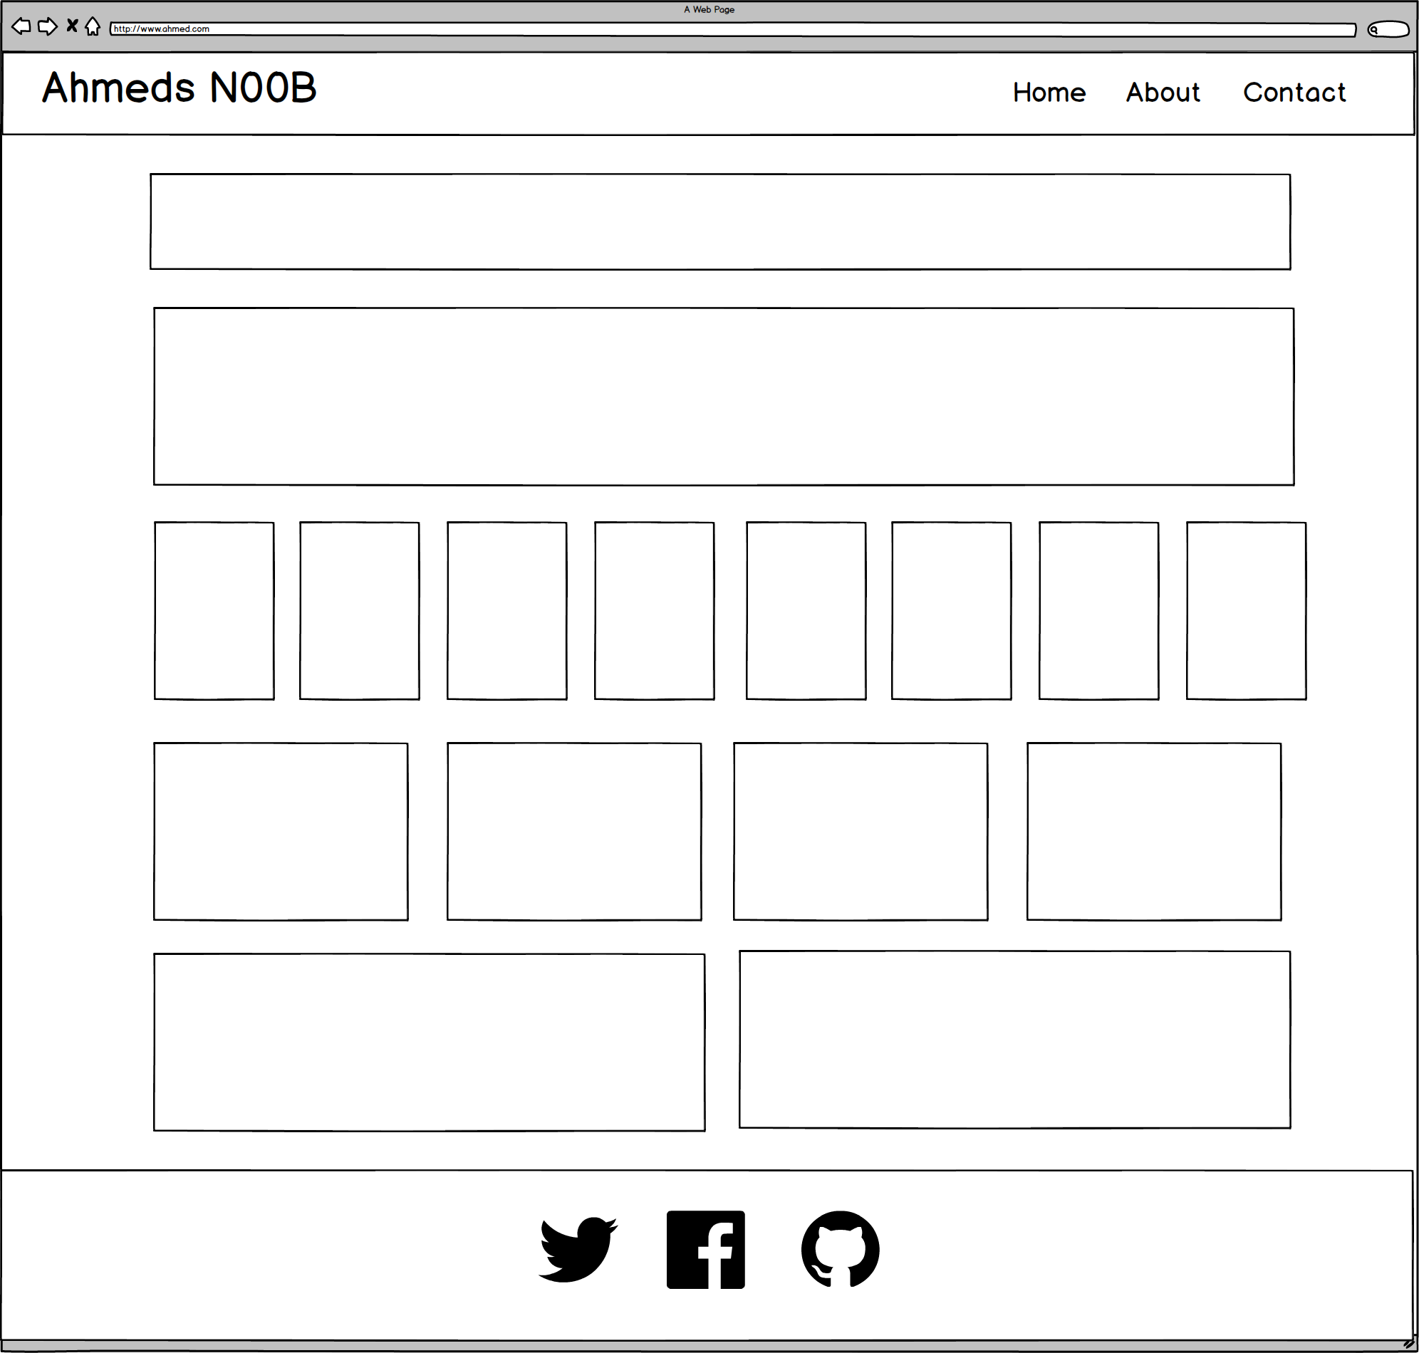

Slide 19
ROWS
1
1
1
1
1
6 Total
1

Slide 20
COLUMNS
1
1
8
4
2
1

Slide 21
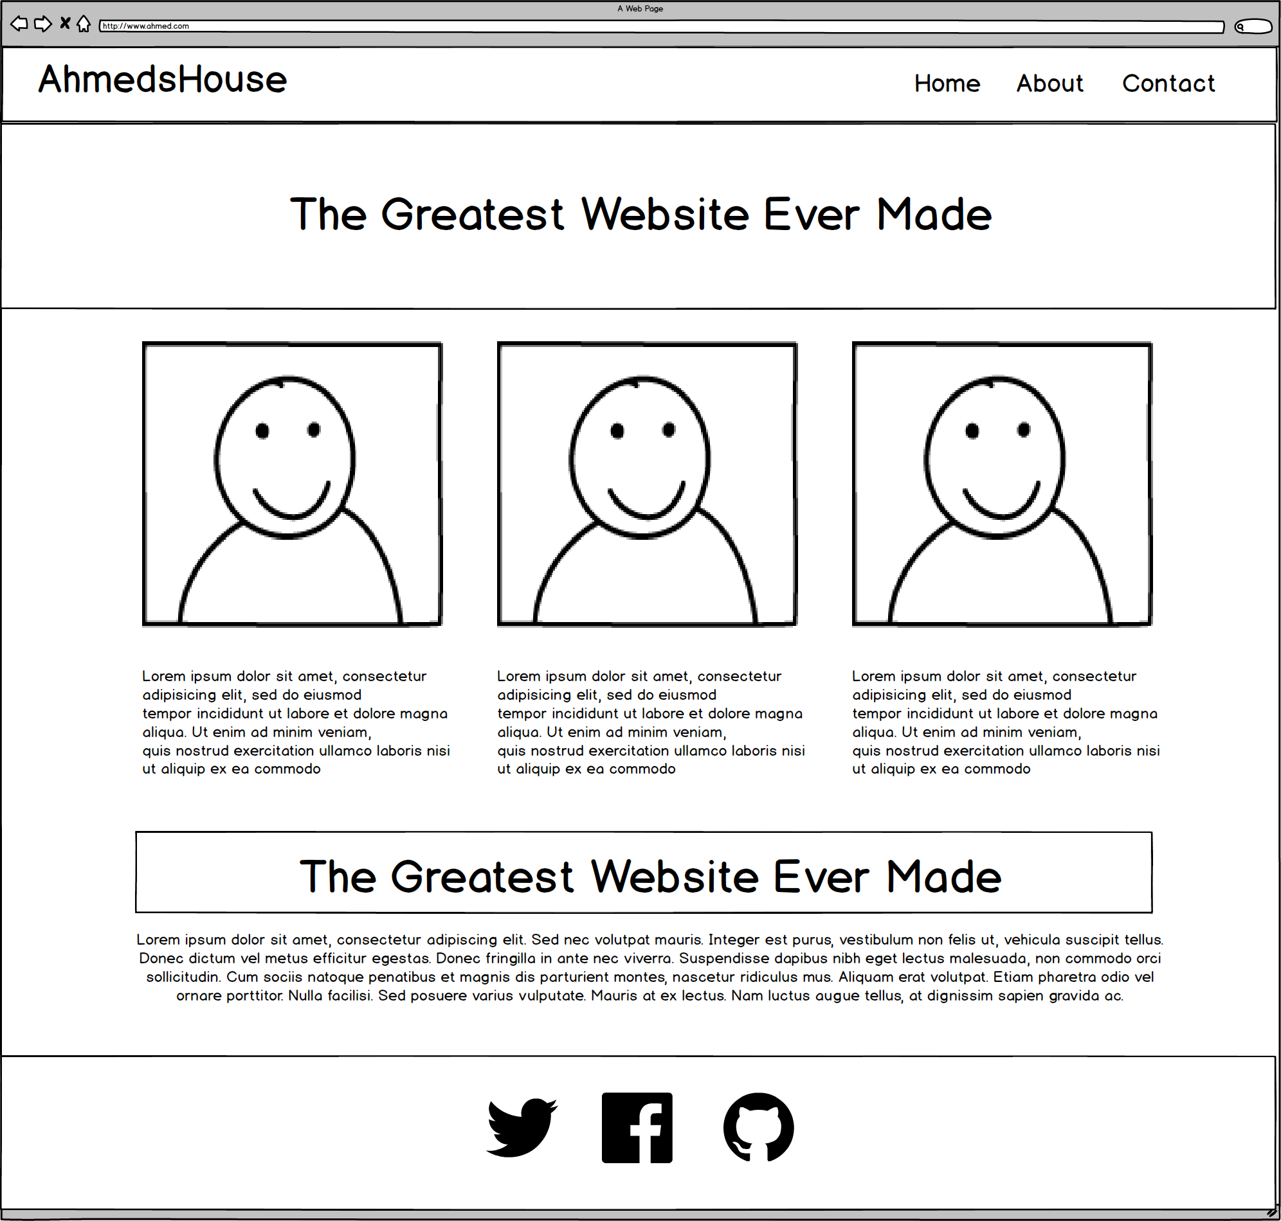

Slide 22
ROWS
1
1
1
4
Total
1

Slide 23
COLUMNS
1
3
1
1

Slide 24
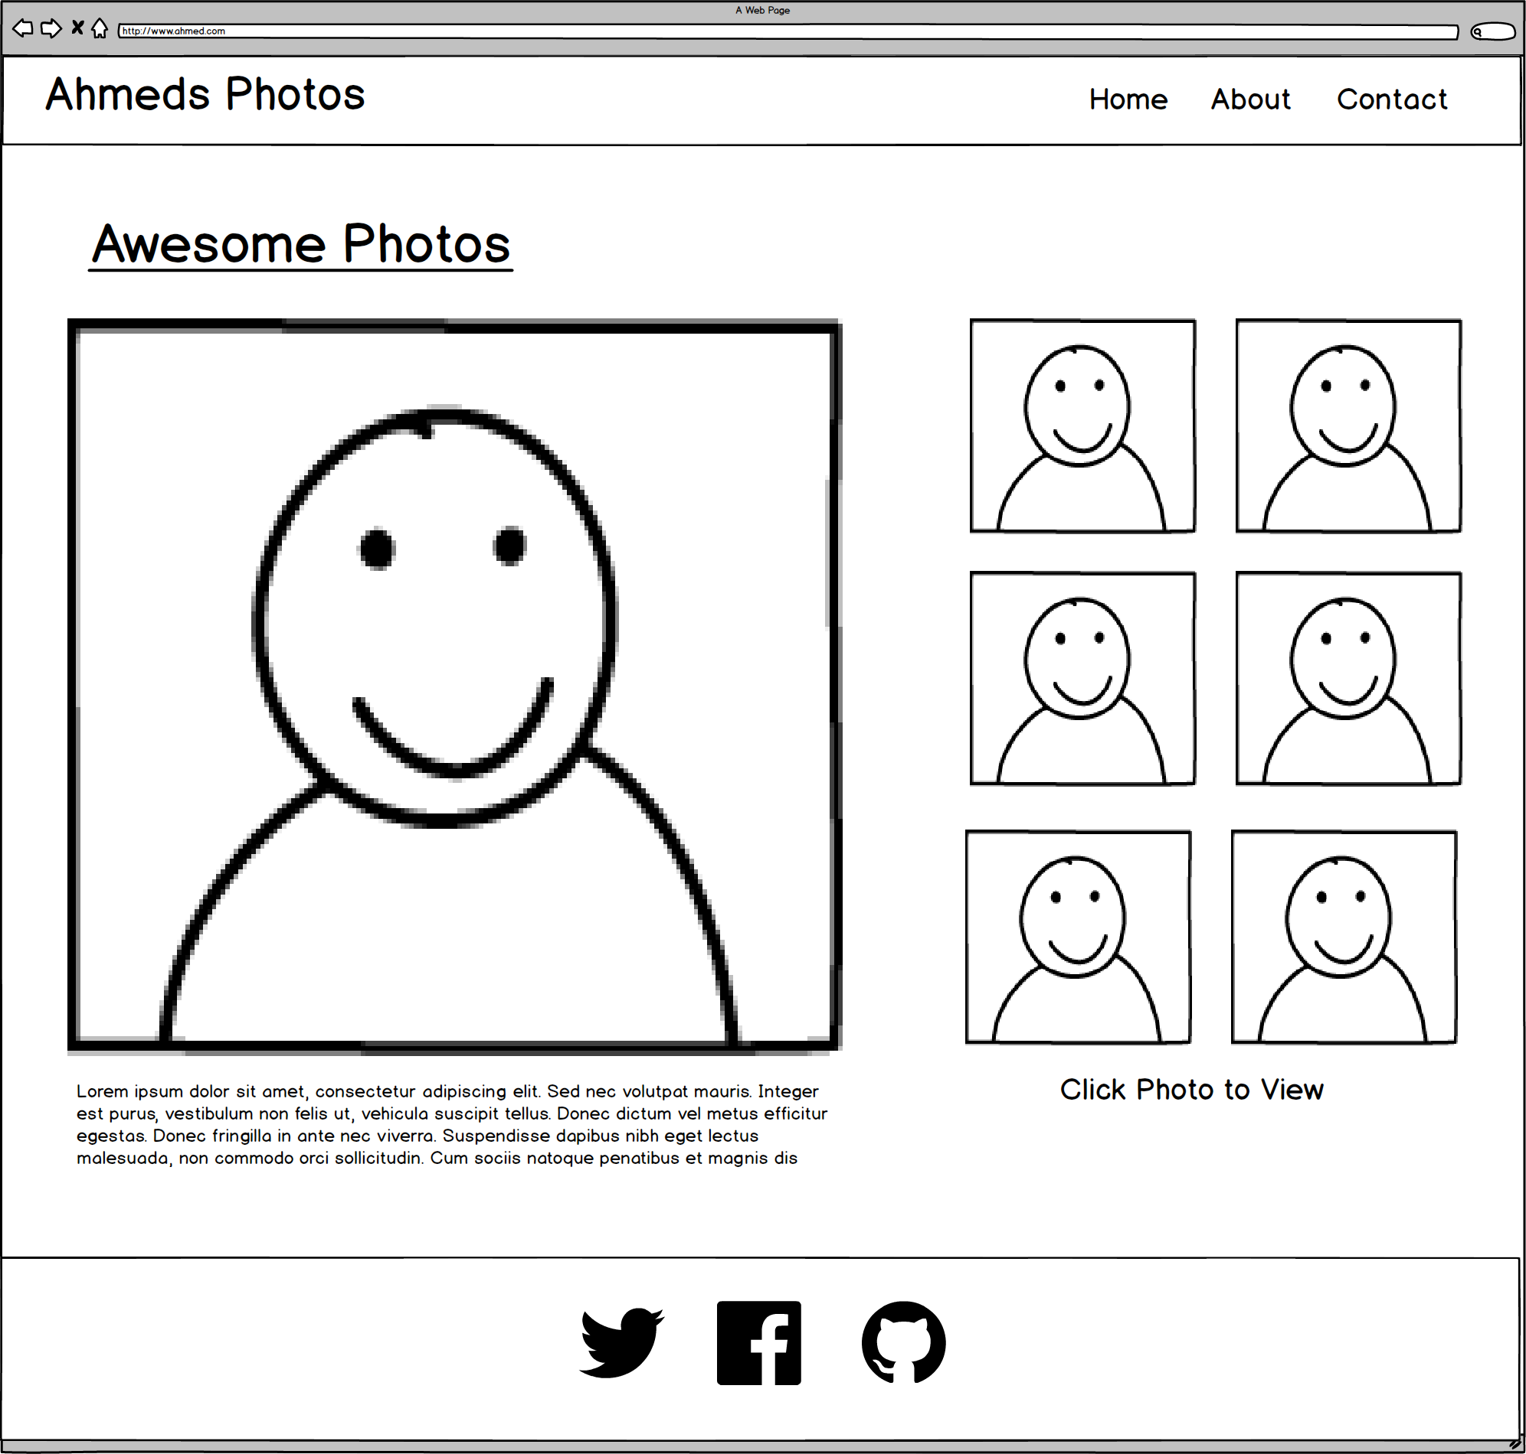

Slide 25
ROWS
1
1
3
Total
1

Slide 26
COLUMNS
1
2
1

Slide 27
SUB-
ROWS
1
1
1
1
4
Total

Slide 28
SUB-
COLUMNS
2
1

Slide 29
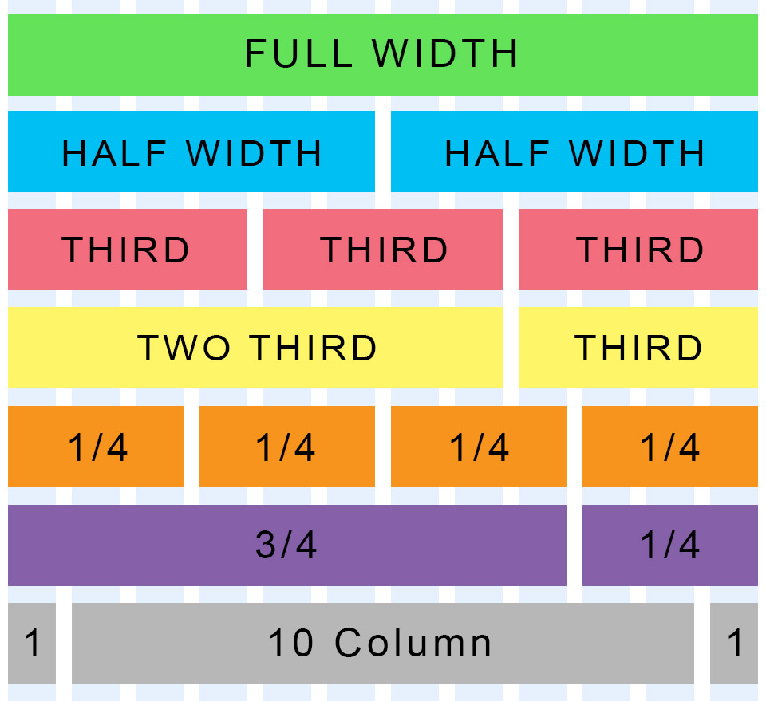
Bootstrap: grid
Bootstrap makes use of a 12 column grid.
You can make designs that use any ratio of those 12 columns.
Grids are made of containers wrapping rows which enclose columns.

Slide 30
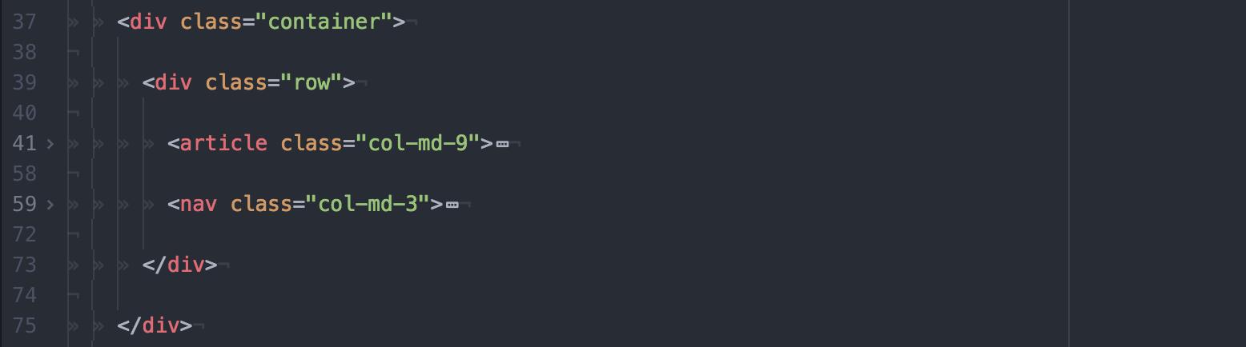
Bootstrap: grid

Slide 31
Assignment: Bootstrap grid layout
Continuing with the same HTML Document, let’s get our layout back.
Make a layout with:
One row, containing two columns. You’ll need a <div> to create a row.
On column for <article>
One column for <nav>
Notes:
Points for those who finish first

Slide 32
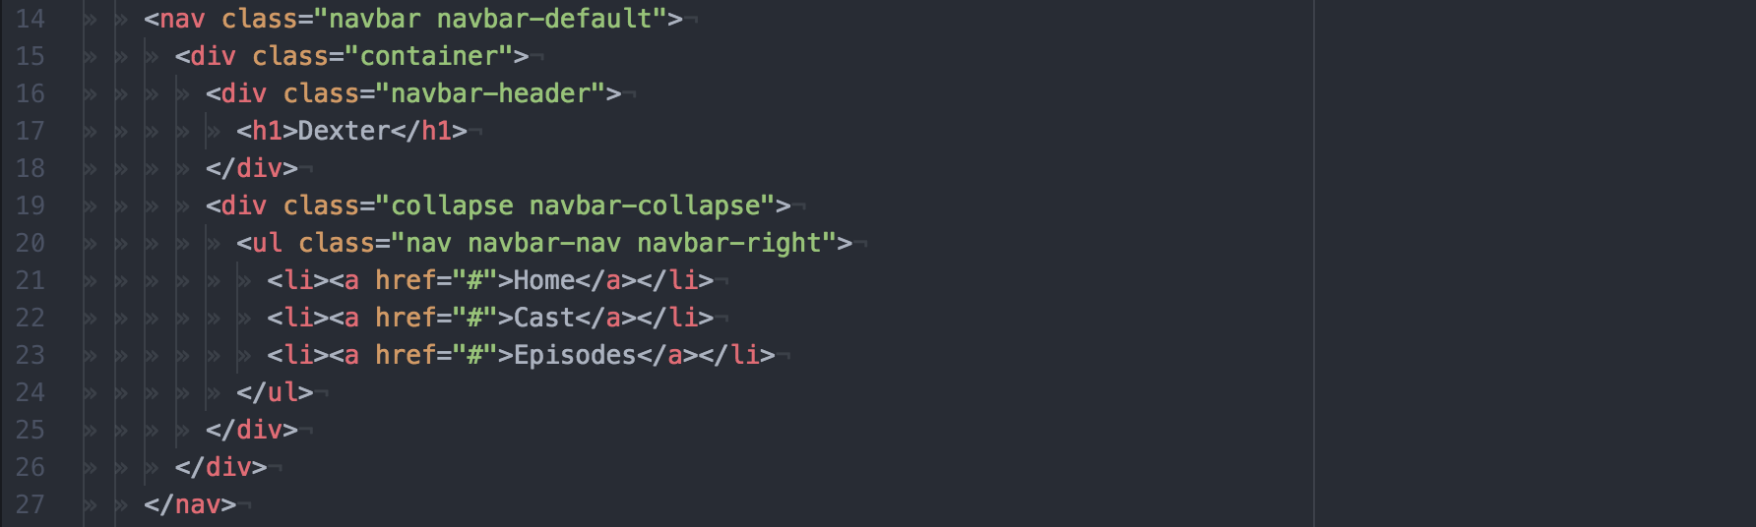
Bootstrap: navbar

Slide 33
Assignment: bootstrap navbar
Continuing with the same HTML Document, let’s add a nice header.
Add a header which spans the full width and includes:
Dexter <h1>
A link for episodes.
A link for cast.
A link back home.

Slide 34
Assignment: layout from sketch
Pick one of the sketches drawn on the board, and implement it’s layout.
Hints:
Leverage grid, you may need to nest them.
Use the thumbnail class on <img>.
Use different text classes to distinguish info.

